Slide 1
What are Exception and Interrupts?
MIPS terminology
Exception: any unexpected change in the internal control flow
Invoking an operating system service from user program
Integer arithmetic overflow
Using an undefined or unimplemented instruction
Hardware malfunctions
Interrupt: event is externally caused
I/O device request
Tracing instruction execution
Breakpoint (programmer-requested interrupt)

Slide 2
Exceptions in MIPS
stage | Problem exceptions occurring
IF | Page fault on IF, misaligned memory access, memory protection violation
ID | Undefined or illegal opcode
EX | Arithmetic exception
MEM | Page fault on data fetch, misaligned memory access, memory protection violation
WB | None

Slide 3
What Happens During an Exception?
An exception occurs
Operating system trap
Saving the PC where the exception happens
Save the operating system state
Run exception code
Resume the last instruction before it traps, or terminate the program

Slide 4
user program
System
Exception
Handler
Exception
return from
exception
normal control flow:
sequential, jumps, branches, calls, returns

Slide 5
Exception Handling in Multi-Cycle MIPS
Consider two types of exceptions:
arithmetic overflow
undefined instruction
First save the address of the offending instruction in Exception Program Counter (EPC).
Transfer control to the operating system (OS) to some specified address.
OS provides some service.
OS can stop the program or restart the program using EPC.

Slide 6
Communicating Exception Reason to OS
Two methods:
Using a status register called Cause Register, holding the reason of exception
Using vectored interrupts. The control is transferred to an address determined by the interrupt cause.
Vectored interrupts example:
The addresses are separated by 32 bytes (8 instructions).
OS performs some limited process.
Exception Type | Exception vector address (in hex)
Undefined instruction | C000 0000_{hex}
Arithmetic overflow | C000 0020_{hex}

Slide 7
Non Vectored Exceptions
A single entry point 8000 0180 _{hex} is used for all exceptions.
The OS is decoding the status register to find the cause.
Two registers are added to the data-path
EPC: 32-bit holding the address of the affected instruction. It is required for vectored exceptions too.
Cause: 32-bit recording the exception cause (some bits unused).
In this example LSB of Cause encodes the exception.
EPC must trim 4 from PC.

Slide 8
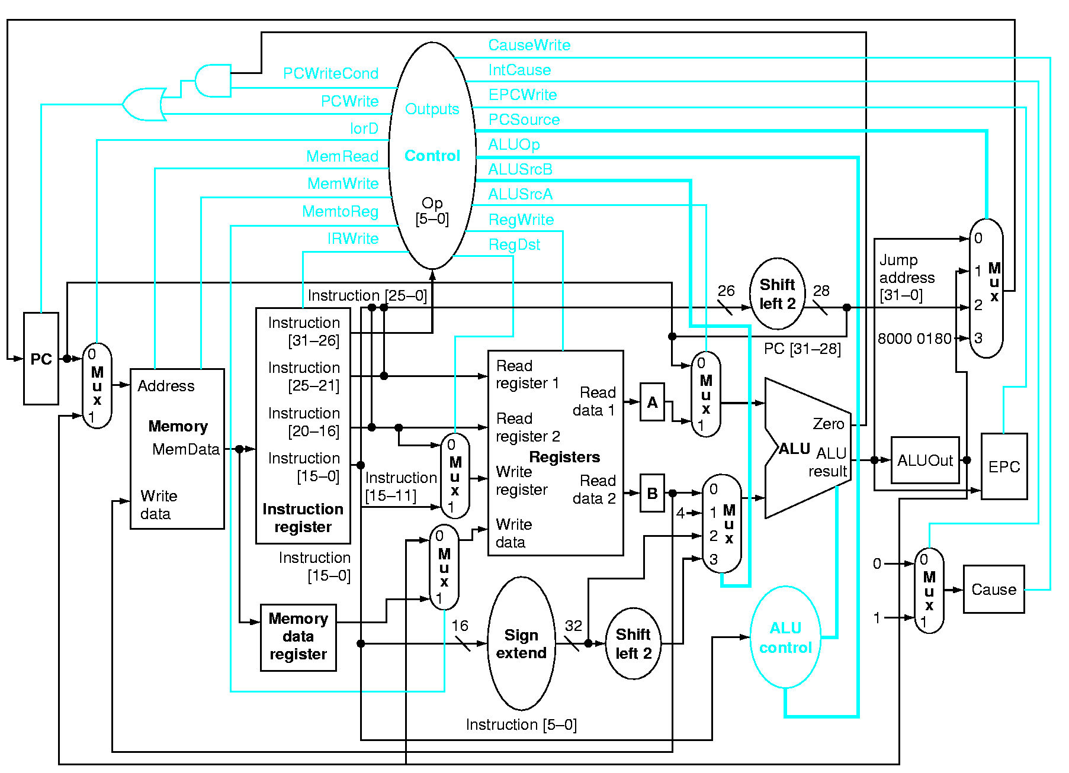
Exceptions Handling in Multi-Cycle MIPS

Slide 9
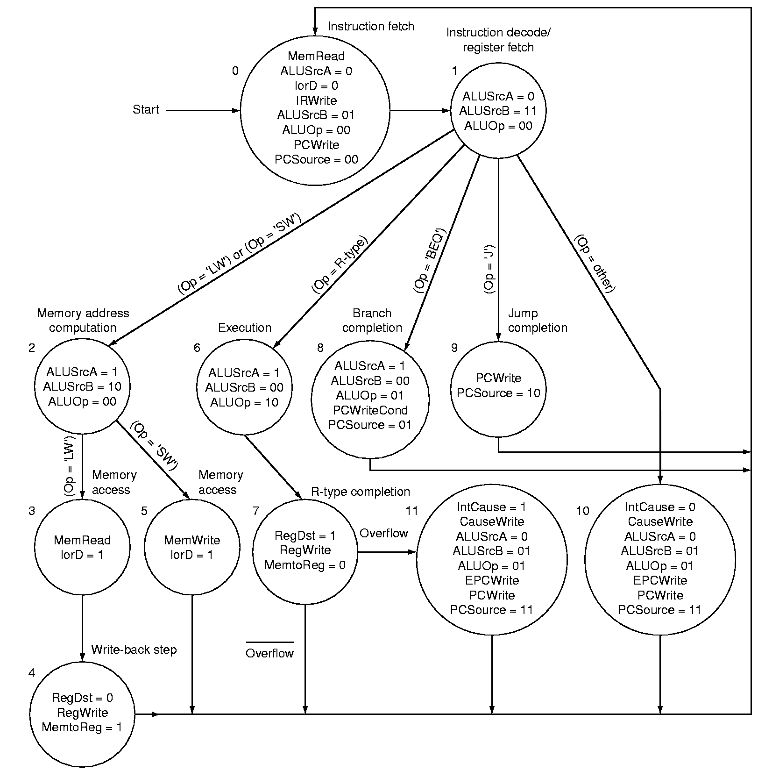
ALU output
overflow.

Slide 10
Exception in pipelined architecture
Force a trap instruction into the pipeline on the next IF
Flush the pipeline for the faulting instruction and all instructions that follow
After exception handling routine finishes, restore the PC of the saved PC and delay branches if exist

Slide 11
Additions to MIPS ISA
EPC (Exceptional Program Counter)
A 32-bit register
Holds the address of the offending instruction
Cause
A 32-bit register
Records the cause of the exception
Status
interrupts mask and enable bits that determines what exceptions can occur.

Slide 12
Control signals to write EPC , Cause, and Status
Be able to write exception address into PC, increase mux set PC to exception address (MIPS uses 8000 00180_{hex} ).
May have to undo PC = PC + 4, since EPC should point to offending instruction (not to its successor); PC = PC - 4
What else?
Flush all succeeding instructions in pipeline

Slide 13
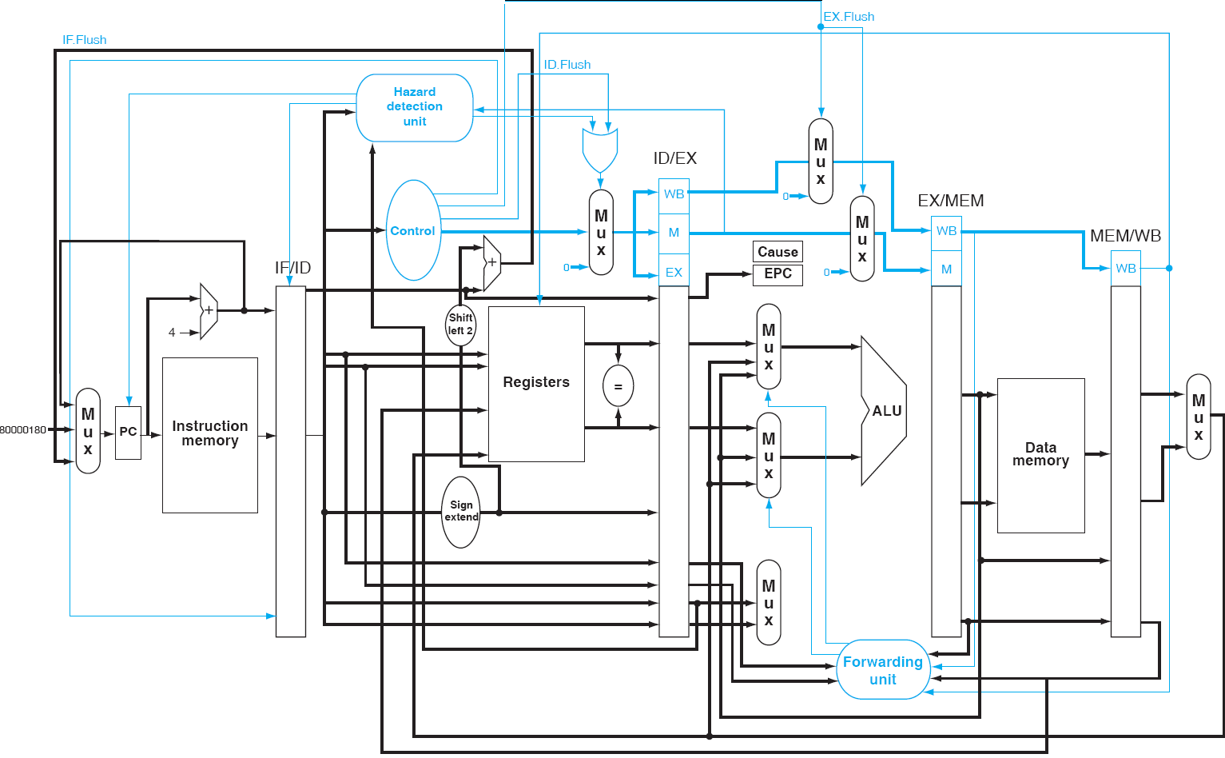
Additions to MIPS ISA

Slide 14
Exceptions example
40hex sub $11, $2, $4
44hex and $12, $2, $5
48hex or $13, $2, $6
4Chex add $1, $2, $1; // arithmetic overflow
50hex slt $15, $6, $7
54hex lw $16, 50($7)
Exception handling program:
80000240hex sw $25, 1000($0)
80000244hex sw $12, 1004($0)

Slide 15
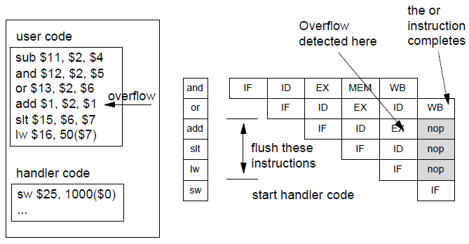

Slide 16
overflow detected
flush IF
flush ID
flush EX
deasserting add
nop
Clock 6

Slide 17
first instruction of exception routine
Clock 7

Slide 18
More on Exceptions

Slide 19
Precise Exceptions
If the pipeline can be stopped so that the instructions just before the faulting instruction are completed and the faulting instruction can be restarted from scratch.

Slide 20
MIPS Exception Mechanism
The processor operates in
user mode
kernel mode
Access to additional set of registers and to user mode restricted memory space available when the processor operates in kernel mode.
The MIPS architecture includes the notion of co-processors.

Slide 21
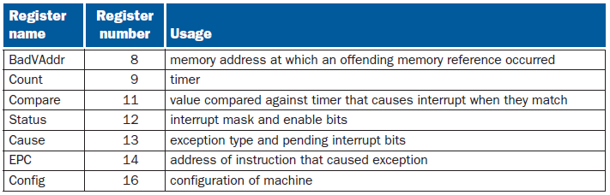
Co-processor
Contains registers useful for handling exceptions
Not accessible in user mode.
Includes the status register, cause register, BadVaddr, and EPC (Exception Program Counter).

Slide 22
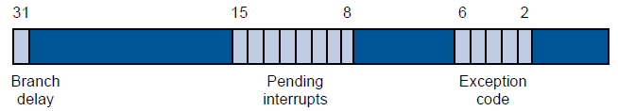
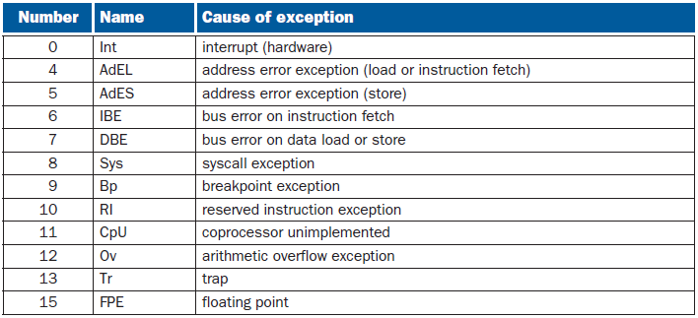
Cause Register
The cause register contains information about pending interrupts and the kinds of exception that occurs.

Slide 23
The contents of the cause register can be copied into an ordinary register and have the individual bits tested to determine what caused an exception to occur.
mfc0 $26, $13
The above instruction moves data from coprocessor0 register $13 (cause register) to general purpose register $26

Slide 24
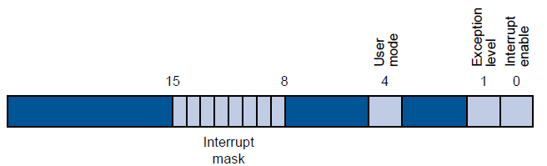
Status Register
The status register contains information about the status of features of the computer that can be set by the processor while in kernel mode

Slide 25
Exception Program Counter (EPC)
Contains the address of the instruction that was executing when the exception was generated.
Control can be made to return to this location to continue the program.
The contents of EPC can be transferred to a general register via the following instruction
mfc0 R_{t}, $14

Slide 26
Exception Handler
MIPS R32 fixes the starting address of the exception handler to 0x8000 0180.
A jump table consists of a list of procedure addresses to be called to deal with the various exception conditions.
In an interrupt, the PC had already been incremented and EPC would contain the correct return address.
In a syscall, the EPC contains the address of the syscall itself, thus the exception handler must first increment the return address by one before the return.

Slide 27
Handling an Exception
An exception has occurred. What happens?
The hardware
copies PC into EPC ($14 on cop0) and puts correct code into Cause Reg ($13 on cop0)
Sets PC to 0x80000180
enters kernel mode
Exception handler (software)
Checks cause register (bits 5 to 2 of $13 in cp0)
jumps to exception service routine for the current exception

Slide 28
As with any procedure, the exception handler must first save any registers it may modify, and then restore them before returning to the interrupted program.
Saving registers in memory poses a problem in MIPS. Addressing the memory requires a register (base) to form an address.
This means that a register must be modified before any register can be saved!
The MIPS register usage convention reserves $26 ($k0) and $27 ($k1) for the use of the interrupt handler.

Slide 29
This means that the interrupt handler can use those without saving them first. A user program that uses those may find them unexpectedly changed!

